Slide 1
Vehicle Management System
Carter Williams

Slide 2
What we will cover
Data Requirements
Development Environment
Overview of the Implementation

Slide 3
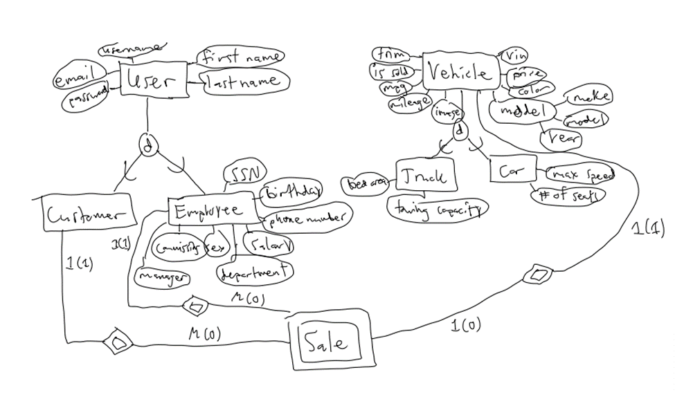
Data Requirements
The database must store the following information for a car dealership:
Data related to employees and customers.
Data related to vehicles.
Data related to the sale of vehicles.
EER diagram for database

Slide 4
Development Environment
Database:
MySQL
InnoDB Storage Engine
Backend:
Python
Django
MySQL Client
Frontend:
Django Templates
Bootstrap
Chart.js

Slide 5
Overview of Implementation
A home page with analytical information.
Three pages for adding/updating entities.
Vehicle, VehicleSale, and Employee/Customer
A login page for employees.
Two pages for finding entities in the database.
Employees/Customers and Vehicles.

Slide 6
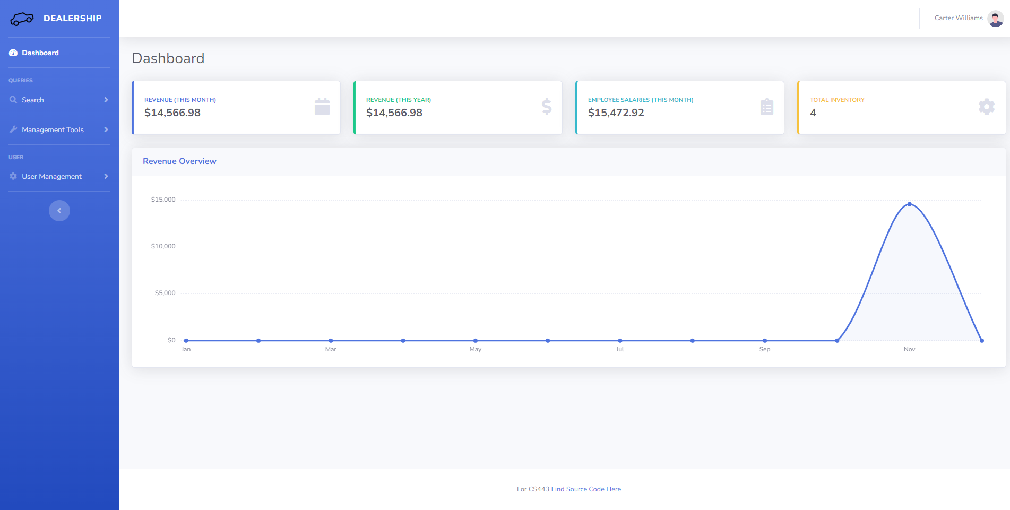
Home Page

Slide 7
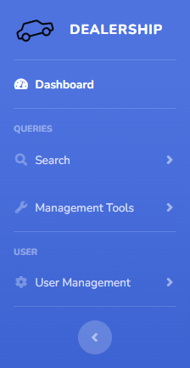
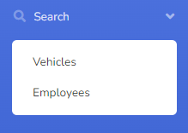
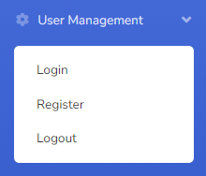
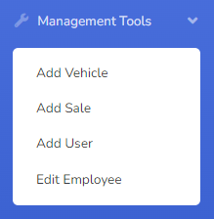
Navigation Menu

Slide 8
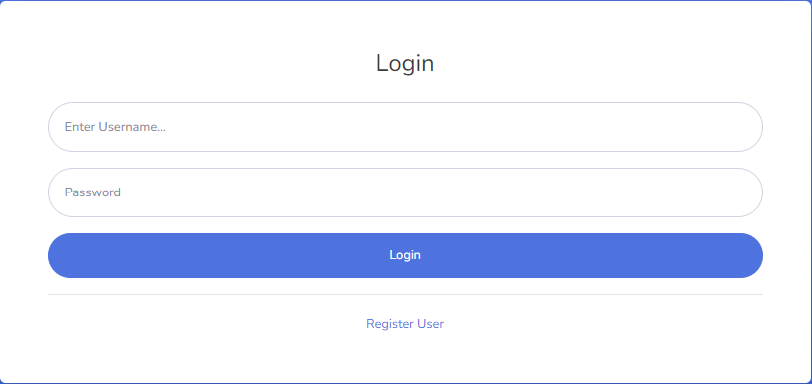
Login

Slide 9
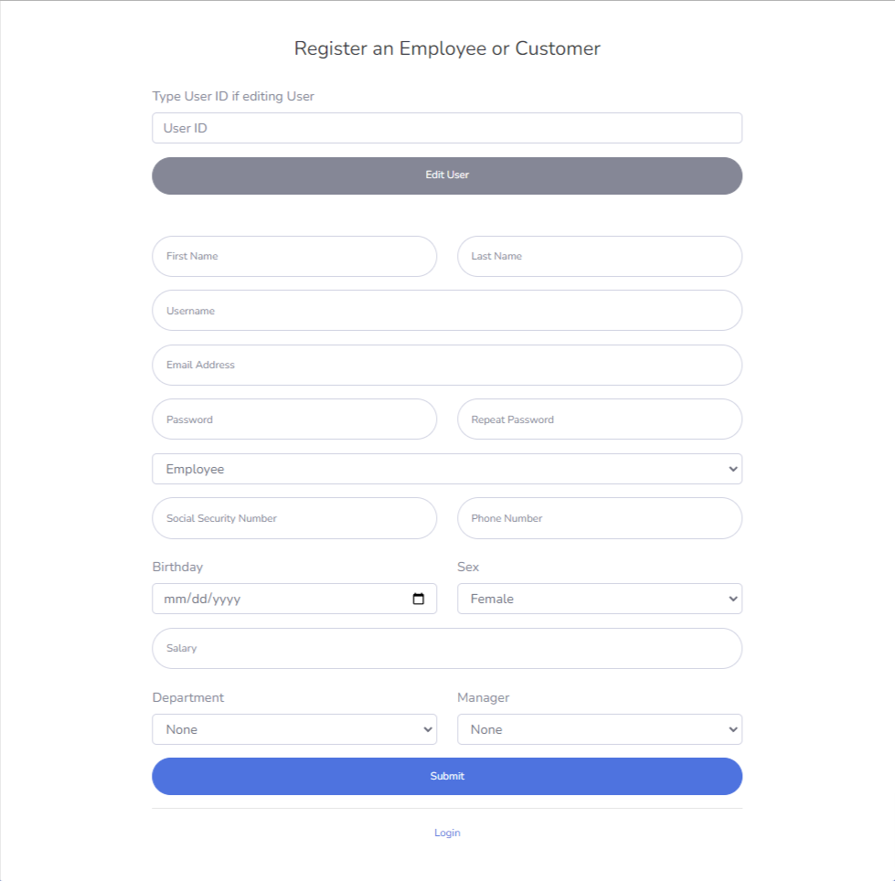
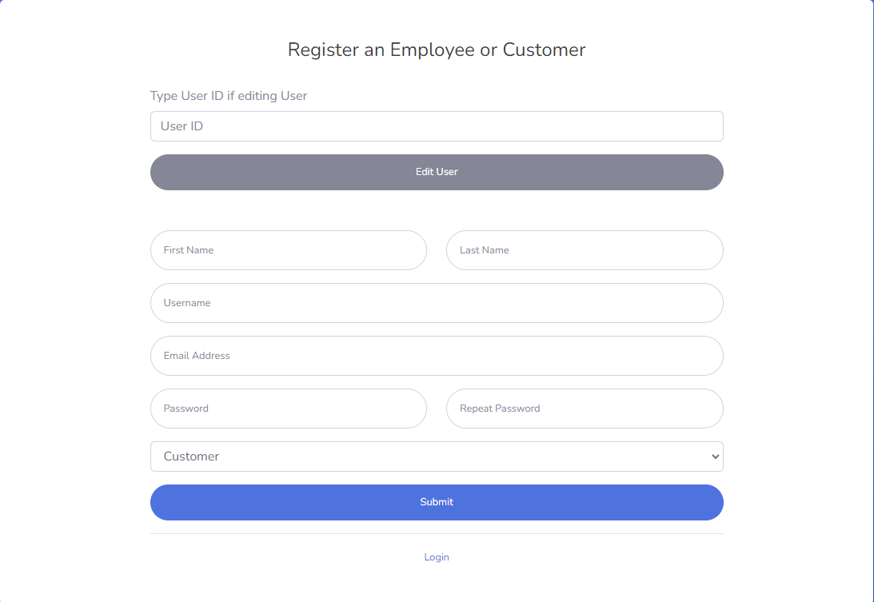
Add/Update Customer or Employee

Slide 10
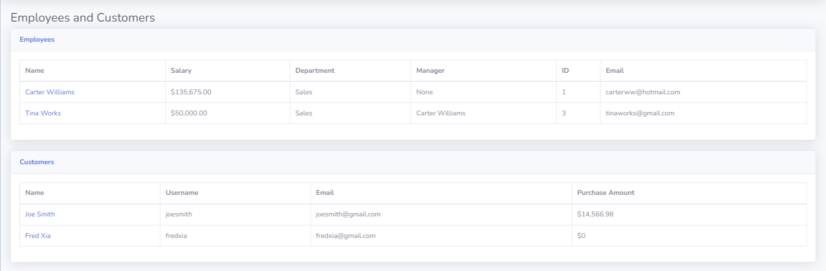
Search for Customer/Employee

Slide 11
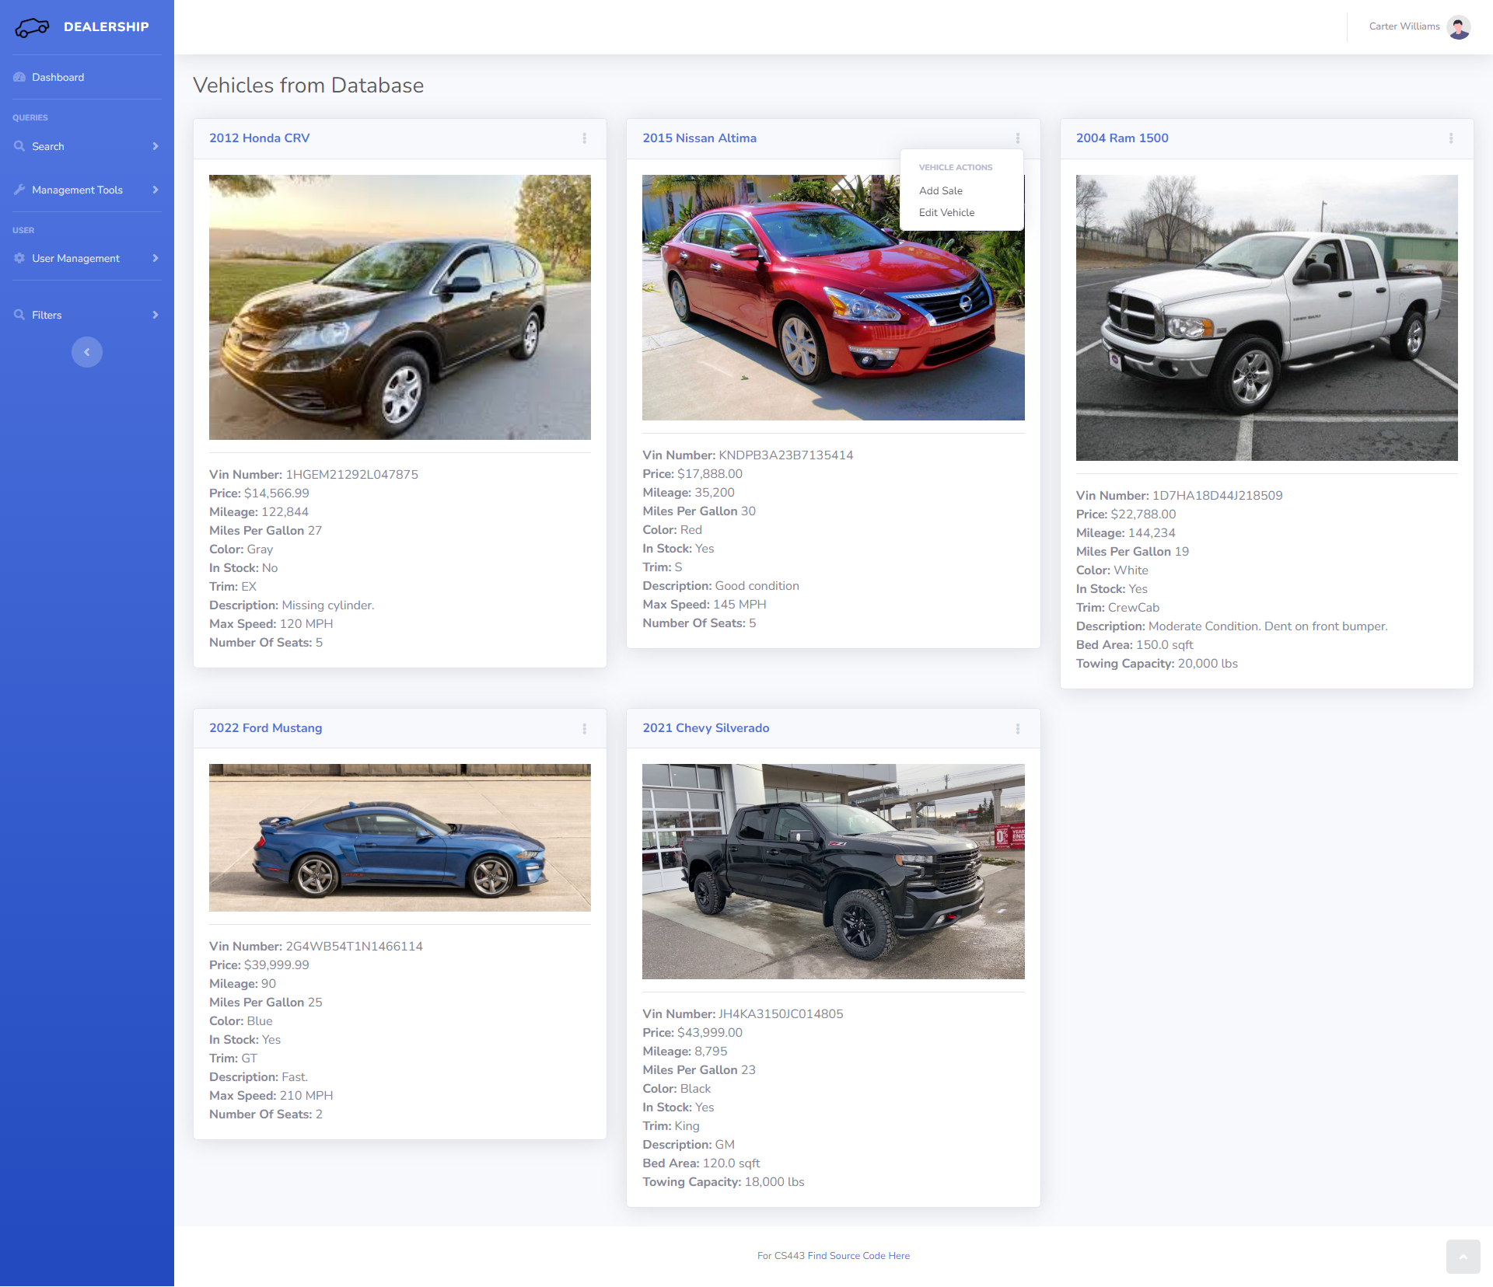
Search for Vehicles

Slide 12
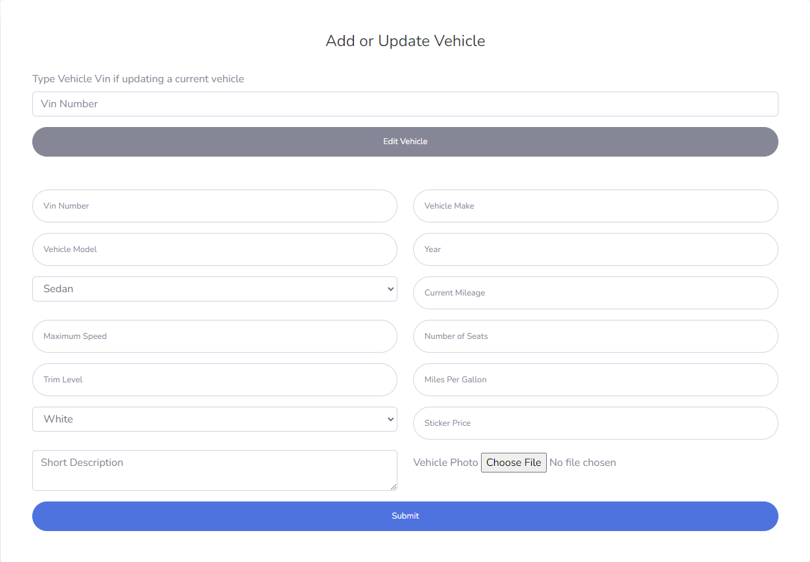
Add/Update Vehicle

Slide 13
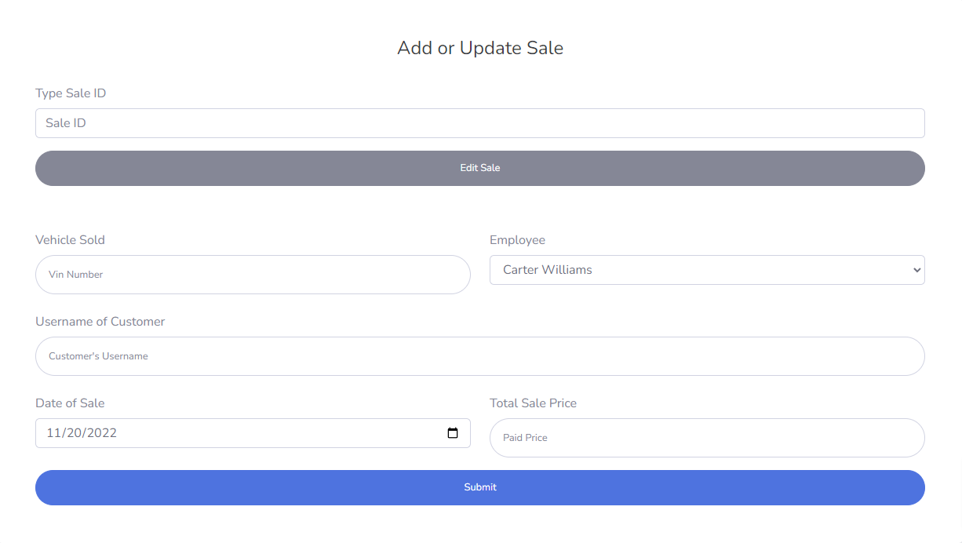
Add/Update Sale

Slide 14
Implementation Details
Each page has a corresponding Python function that handles database interaction.
Most database interactions were not written in raw SQL.
Django has methods that correspond to SELECT, JOIN, UPDATE, INSERT, and DELETE.
Each function is wrapped in a transaction that rolls back if an exception is thrown.

Slide 15
Physical Design
Tables have a sorted structure on the primary key.
Each table is contained in its own tablespace.
Each primary key has a primary index, and each foreign key has a secondary index.
Indexes are B+ trees.
Added indexes on non-primary key columns are secondary indexes.

Slide 16
Questions?

